Slide 1

Vodafone
Employees Performance & HR Cost Analysis
Optimizing Resource Allocation and Employee Productivity
Yousef Mohamed | Data Scientist

Slide 2

Agenda
1 | Introduction
2 | Data preprocessing
3 | Employee Performance Dashboard overview
4 | HR Cost Dashboard overview
5 | Insights from Employee performance Dashboard
6 | Insights from HR cost Dashboard
7 | Actionable Instights
8 | Conclusion
Yousef Mohamed | Data Scientist

Slide 3

Introduction
Overview of the project’s goal:
Analyzing employee performance and HR costs for Vodafone telecommunication company over different regions to improve decision-making and operational efficiency.
Yousef Mohamed | Data Scientist
Back to Agenda

Slide 4
Data Preprocessing
1- Collecting Employees’ Data from Different excel sheets (sheet for each region) into only one sheet
2- Handled missing values
3- Corrected data inconsistencies
4- Ensured data accuracy for performance and HR cost analysis.
5-Merge Employee_Dept table with HR cost Table
6- Extract relationship between the Employees table and HR cost table using EMP_ID
Yousef Mohamed | Data Scientist
Back to Agenda

Slide 5
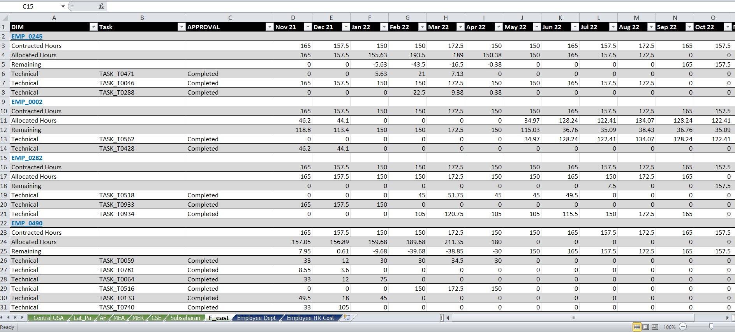
Before Data preprocessing
(10 sheets)
Yousef Mohamed | Data Scientist
Back to Agenda

Slide 6
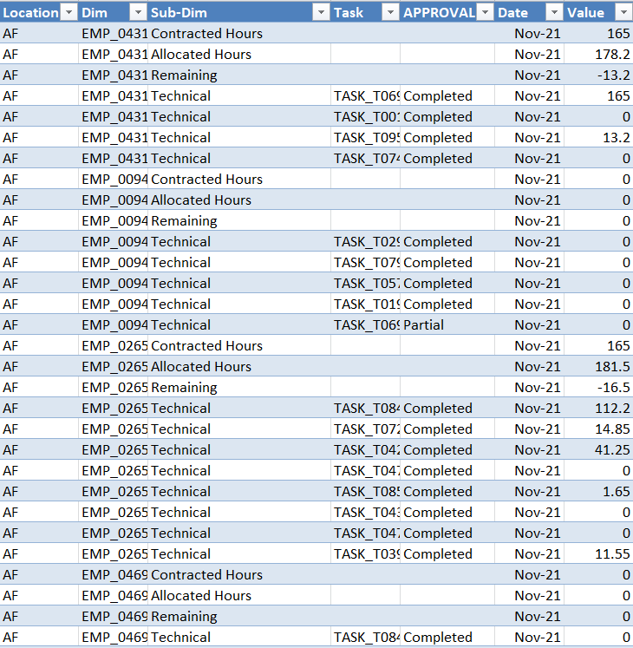
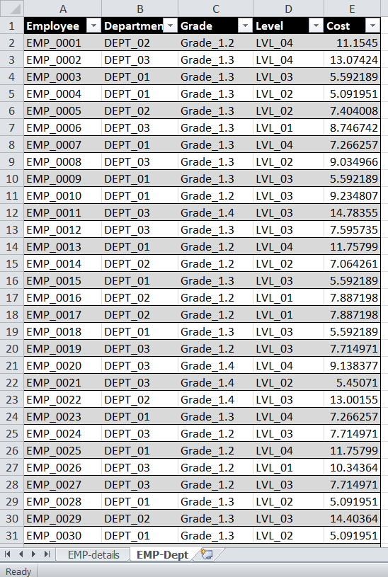
After Data preprocessing
(2 sheets)
Back to Agenda
Yousef Mohamed | Data Scientist

Slide 7




Now, It's time to discover our Dashboard
Yousef Mohamed | Data Scientist

Slide 8
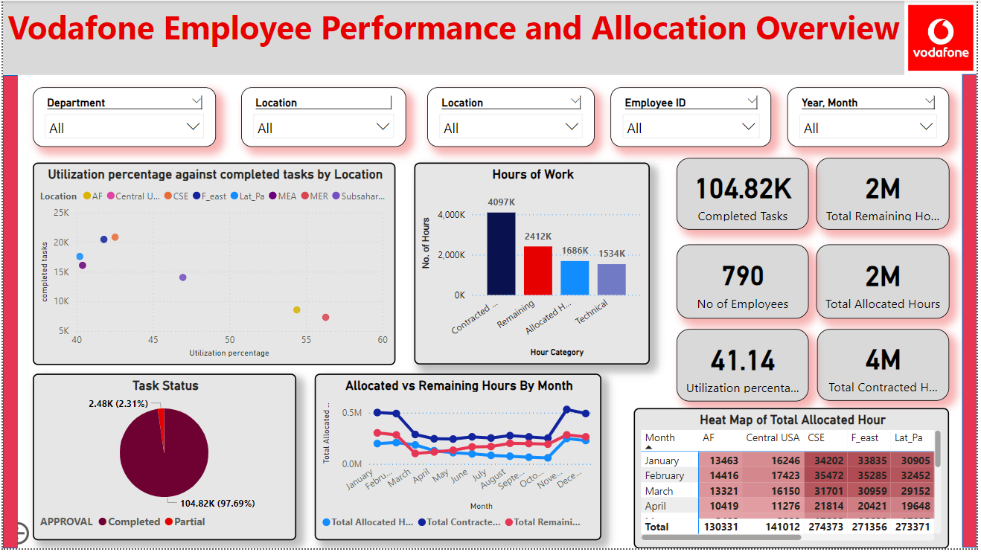
Yousef Mohamed | Data Scientist

Slide 9
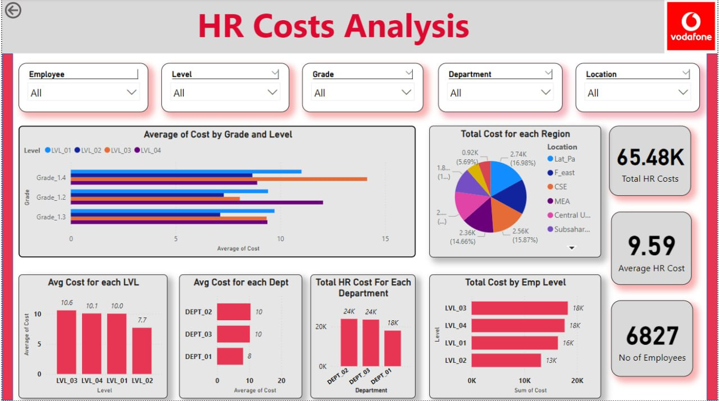
Yousef Mohamed | Data Scientist

Slide 10
Insights from Employee Performance
•- Identified underutilized and overworked employees
•- Optimized workload distribution across months and locations
•- Improved task management and productivity
Yousef Mohamed | Data Scientist

Slide 11
Insights from HR analysis
•- Cost distribution by region, department, and employee level
•- Identified cost-saving opportunities
•- Resource optimization based on cost analysis
Yousef Mohamed | Data Scientist

Slide 12
Actionable Insights
•Actionable steps:
•- Address underutilized or overworked employees
•- Implement cost-saving measures in high-cost areas
•- Optimize resource allocation based on performance and cost trends
Yousef Mohamed | Data Scientist

Slide 13
Conclusion
•The dashboards provide valuable insights into employee performance and HR costs, enabling data-driven decisions to optimize operations and reduce costs.
Yousef Mohamed | Data Scientist

Slide 14




Connect with me.
Email
yousefesa36@gmail.com
LinkedIn
https://www.linkedin.com/in/yousef-mohamed-8a4132221?utm_source=share&utm_campaign=share_via&utm_content=profile&utm_medium=android_app
Call me
+20 1154486842
Yousef Mohamed | Data Scientist

Slide 15

Thank You
Yousef Mohamed | Data Scientist

